Slide 1
Join classsifier and index mutation using sequential labellling

Slide 2
Abstract:
The sequential labeling model is commonly used for time series or sequence data where each instance label is classified using previous instance label. In this work, a sequential labeling model is proposed as a new approach to detect the type and index mutations simultaneously, using DNA sequences from lung cancer study cases. Bidirectional Long Short-Term Memory (BiLSTM), and Bidirectional Gated Recurrent Unit (Bi-GRU). Each nucleotide in the patient’s DNA sequence is classified as either normal or with a certain type of mutation in which case, its index mutation is predicted. Based on the experiments that were conducted using EGFR gene, BiLSTM and Bi-GRU displayed better performance and were more stable than 1D-CNN. The proposed model reports F1-scores of 0.9596, and 0.9612 using Bi-GRU and BiLSTM, respectively. Based on the results the model can successfully detect the type and index mutations in the DNA sequence more accurately and faster without the need for other supporting data and tools, and does not require re-alignment to reference sequences. This will greatly facilitate the user in detecting type and index mutations faster by entering only the DNA sequence.

Slide 3
SEQUENTIAL LABELLING
Sequential labeling is one of the tasks for time series or sequence data and is included in N-to-N tasks, where the model will accept N inputs and produce N outputs for each available input. Problems included in sequential labeling are entity recognition [1], part of speech tagging [2], semantic role labeling [3], keyword extraction [4], and other tasks that implement sequential labeling models.

Slide 4
METHODS
The proposed sequential labelling model for detecting the type and index simultaneously of genetic mutations in the DNA sequence data uses 1D-CNN, BiLSTM, and Bi-GRU model. Data sequences, from the DNA sequence of ten genes in lung cancer that have the most mutations, including EGFR, TP53, KRAS, CTNNB1, SMARCA4, CDKN2A, PTPRD, BRAF, ERBB2, and PTPRT, are selected in this study to test the efficacy of the model.
This section presents the detailed steps including preprocessing, data division into training data, validation, and testing, as well as the design and implementation of sequential labelling models using 1D-CNN, BiLSTM, and Bi-GRU in detecting the type and index mutations

Slide 5
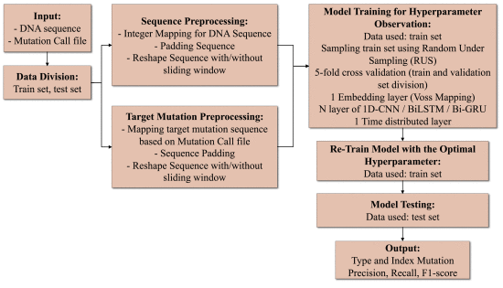
FLOW DIAGRAM

Slide 6
Observations were made to test the performance level of mutation type and index detection using 1D-CNN, BiLSTM, and Bi-GRU sequential labeling model on ten genes in the lung cancer dataset based on training and validation loss in the training process, running time (training and testing time) in seconds,

